Slide 1
4 musketeers
Spyne.ai (Computer Vision Hackathon) Changing Dress Color – Problem B

Slide 2
Spyne.ai (Computer Vision Hackathon)
Problem Statement
Approach to the Solution
To produce different variants of colour of a dress. Test data, if required, can be downloaded from any regular e-commerce portals, such as Myntra, Amazon, Flipkart, etc.
To build a web application which solves this problem statement, with UI similar to ecommerce websites relevance to theme: sticking to the organizational problem statement's needs and a simple UI to match e-commerce websites
Relevance to the Theme
Techstack Involved
We are going to stick to the organizational problem statement, and present it in a way that is similar to ecommerce websites as amazon
We would be using HTML,CSS, SASS/SCSS , JS to solve this problem

Slide 3
Details of Technology Stack
HTML5
Tech1
CSS 3
Tech2
Tech3
SASS/SCSS/ JS

Slide 4
Description of the Solution
Step 1
Step 2
Research
Plan
2021
Step 3
Step 4
Code
Test

Slide 5
Novelty of the Solution
Describe how your solution is unique and original.
Why the problem you are catering is needed to be solved. Our project is a Web Application that enables it's user to view different garments available online, and to view different colours available for them. We do not really have platforms which allow people to choose their t-shirts or jeans in different colours, the photographers have to take extra steps to ensure that they click pictures of every available colour option to present it to people, what if there was a way to directly enter hex codes, or choose colour from a pallete and have it delivered to your home? So with this problem statement in mind, we designed our web-app. With a super simple User Interface, we make choosing your favorite colour easy. Under the hood, we have a really simple web-app, resembling the most popular E-Commerce websites and user familiarity. We hope that anyone would be able to use our web app without any former knowledge about it.

Slide 6
Growth Plan of the Product
(You can modify percentage according to your requirement)
10%
Research and Initial Documentation
Set-up front end
Checkpoint 1
25%
Create a chatbot
Implement UI/UX principles
Checkpoint 2
50%
Explore ways to implement our idea
Checkpoint 3
75%
Integrate front end and back end
Deploy over cloud
Run checks
Checkpoint 4

Slide 7
Business Aspects of the Hack
01
Market Impact
People can now have a large variety of colours to choose a dress
Target Consumers
02
People who shop from e-commerce sites
03
Financial Sustainability
How you plan on maintaining a stable finance model?
Product > Project
04
How your project is ready to be a product?

Slide 8
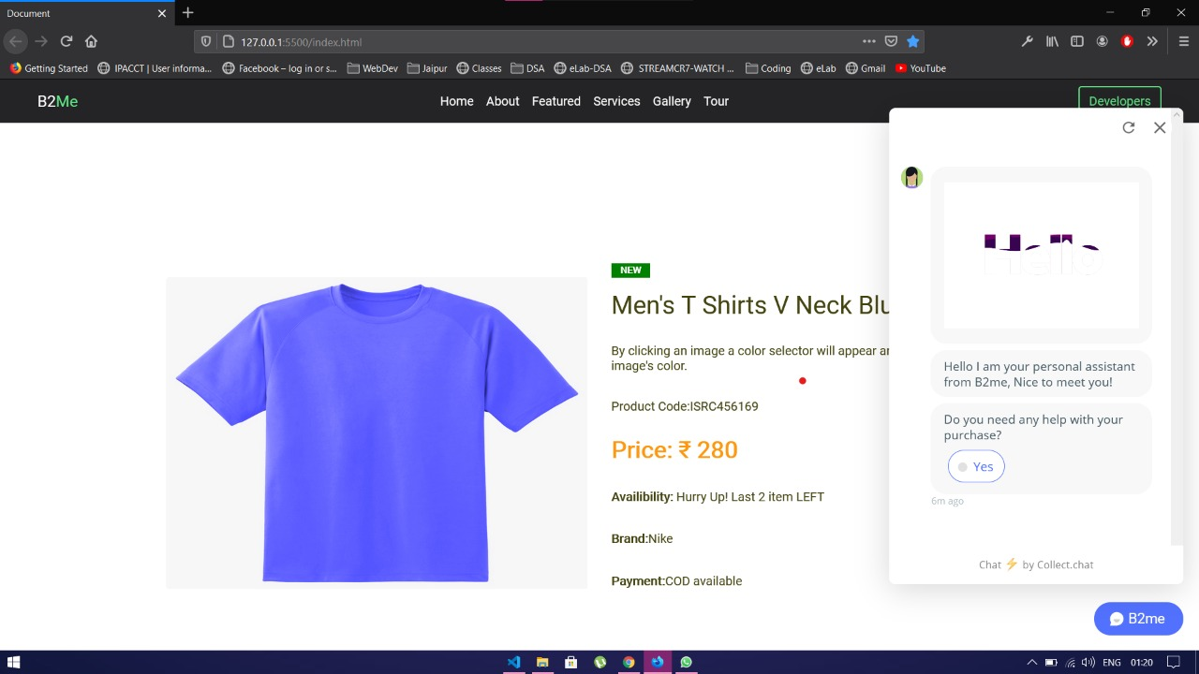
Working Prototype
Landing Page:

Slide 9
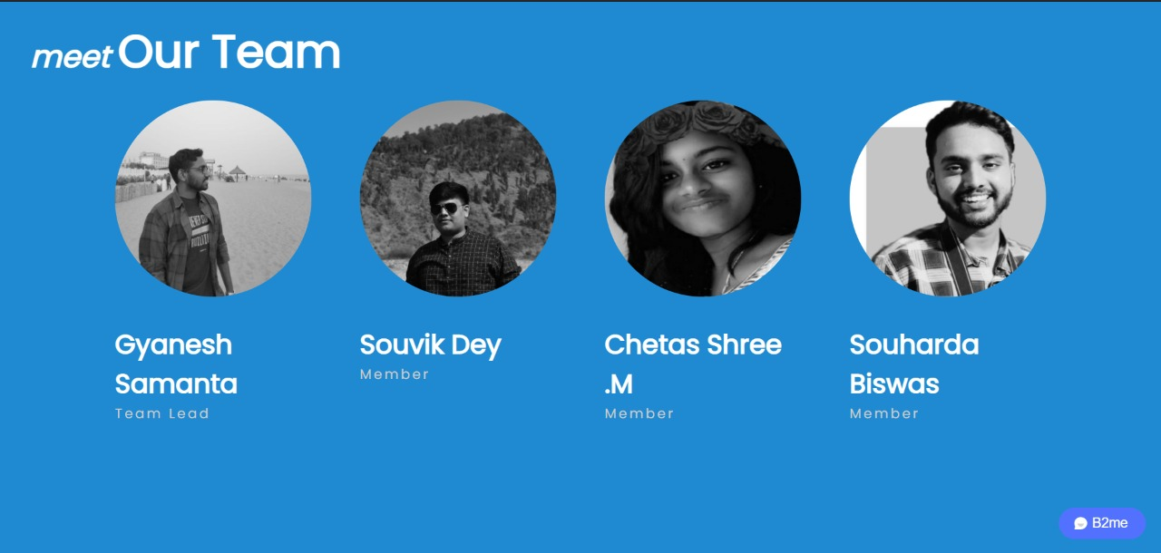
Working Prototype
Developer’s Page:

Slide 10
Working Prototype
Link to Website: https://b2me.netlify.app/ Video link: https://drive.google.com/file/d/1six2nfSNUnXZG7qwrpPSr4IZtyHbkB19/view?usp=sharing

Slide 11
Learning Curve
What have you learnt by doing this project?
04
01
Growth 1
To identify the problem which are faced by many e-commerce site users
03
02
Growth 2
02
To strategise the solution of the problem statement
01
03
Growth 3
To research about the problem and thr requirements needed to solve it
04
Growth 4
To learn how to execute the solution

Slide 12
About Team
01
02
Gyanesh Samanta
Chetas Shree.M
Team Lead
Member
03
04
Souharda Biswas
Souvik Dey
Member
Member

